Slide 1


A Comprehensive Review of Deep Learning Architectures for Task specific Analysis
Submitted in partial fulfilment of the requirement of the degree of
BACHELOR OF TECHNOLOGY
to
K.R. Mangalam University
by
Sahil Bhardwaj(2301010425)
Rishav Kumar(2301010424)
Ayush Verma(2301010447)
Notes:
New Courses replaced with New Programmes

Slide 2

Content
Abstract
Introduction
Literature Survey
Problem Definition
Proposed Work
Methodology and Implementation
Results & Discussion
Conclusion
References
Notes:
New Courses replaced with New Programmes

Slide 3
Abstract
Deep learning has truly changed the game across numerous fields, reshaping how we tackle complex challenges by providing highly precise and efficient solutions tailored to particular needs. Just picture a system that can create text, summarize information, translate languages, classify data, answer questions, and even reason—deep learning makes all of this a reality. In this review, we took a closer look at different deep learning architectures and see how they drive these various applications. We analysed the past studies and reveal the datasets that power these models, as well as the design principles that influence their performance. Throughout this we emphasized the strengths that set these architectures apart, along with the limitations that pose challenges to their effectiveness. This review acts as a guide for researchers, practitioners, and industry professionals, helping them choose and adapt the right deep learning models for specific tasks.
Keywords: Deep Learning, Deep Learning Architectures, Task Specific Review, Systematic Review
Notes:
New Courses replaced with New Programmes

Slide 4
Introduction
Deep learning has transformed various domains by automating complex tasks with high accuracy.
Neural networks, especially deep architectures, are capable of learning patterns directly from raw data.
This review explores deep learning models for tasks such as:
Text generation, Translation, and Summarization
Question Answering and Reasoning
Text Classification and Reading Comprehension
Focus on analyzing architectures, datasets, strengths, and limitations of various models.
The goal is to guide researchers and practitioners in selecting the right models for specific tasks.
Notes:
New Courses replaced with New Programmes

Slide 5
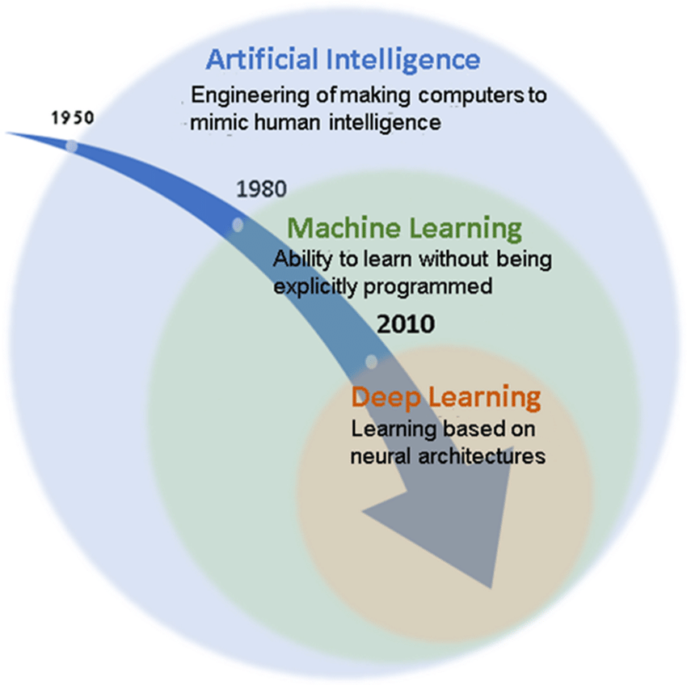
Literature Survey
Understanding the Evolution of Deep Learning:
✅ Traditional Machine Learning → Deep Learning Evolution
✅ Feature Engineering → Neural Networks for Automatic Learning
✅ Rise of CNNs, RNNs, LSTMs, and Transformers
✅ Impact on NLP tasks like classification, translation, summarization, and QA.
Figure 1: Evolution of Deep Learning
Notes:
New Courses replaced with New Programmes

Slide 6
Literature Survey
Comparison of Deep Learning Architectures:
Model | Task | Strengths | Limitations
CNNs | Text Classification | Captures local patterns. | Poor at long dependencies.
RNNs & LSTMs | Summarization, Translation | Sequential processing. | Slow for long texts.
BERT | QA, Reading Comprehension | Deep contextual learning. | High computational cost.
GPT | Text Generation, Reasoning | Fluent generation | Prone to Hallucination.
T5 & BART | Summarization, Translation | Text-to-text training | Requires extensive data.

Slide 7
Problem Definition
Despite the rapid advancements in deep learning, there is a lack of a comprehensive, systematic review that explores how specific deep learning architectures perform across different tasks such as text generation, summarization, translation, classification, question answering, and reasoning. Each task presents unique architectural needs, and existing literature often lacks a unified analysis of the models, datasets used, their design principles, strengths, limitations, and performance trade-offs. Therefore, this study aims to:
Identify the most commonly used deep learning architectures across specific tasks.
Explore the datasets powering these models and the rationale behind their design.
Analyze the strengths and weaknesses of various models in task-specific contexts.
Provide guidance for choosing appropriate architectures and datasets to improve interpretability, generalizability, and efficiency.
Notes:
New Courses replaced with New Programmes

Slide 8
Proposed Work
This paper proposes a systematic review and task-specific analysis of deep learning architectures across seven key NLP and AI tasks: Reading Comprehension, Translation, Summarization, Question-Answering, Text Generation, Reasoning, Text Classification.
Notes:
New Courses replaced with New Programmes

Slide 9
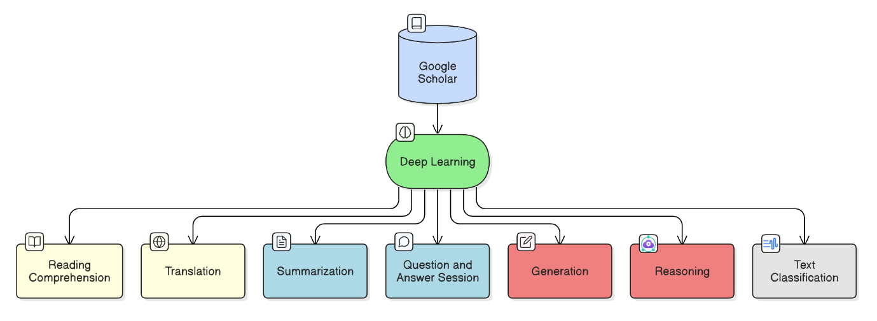
Methodology and Implementation
Figure 2: Research Design and methodology
Notes:
New Courses replaced with New Programmes

Slide 10
Result and Discussion
This paper provides an in-depth comparison of various deep learning architectures for different task-specific applications.
Deep learning models have significantly advanced task-specific applications such as text classification, summarization, translation, question answering, and reasoning.
Transformer-based architectures (BERT, GPT, T5, etc.) dominate most tasks, outperforming traditional RNN and CNN models due to their self-attention mechanisms and scalability.
Task-specific adaptation is crucial—different architectures excel at different tasks:
BERT and RoBERTa for text classification and question answering.
GPT models for text generation and reasoning.
CNNs & LSTMs for structured classification tasks.
T5 and BART for text summarization.
Datasets play a critical role—the availability of high-quality, large-scale datasets (e.g., SQuAD, GLUE, CNN/Daily Mail) directly impacts model performance.
A snapshot of the observed models and datasets is provided in Figure 2-9.
Notes:
New Courses replaced with New Programmes

Slide 11
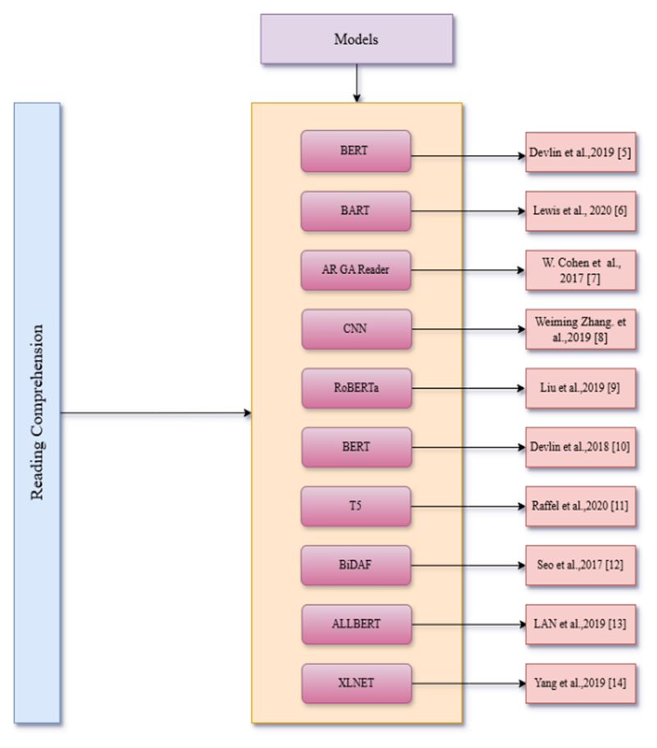
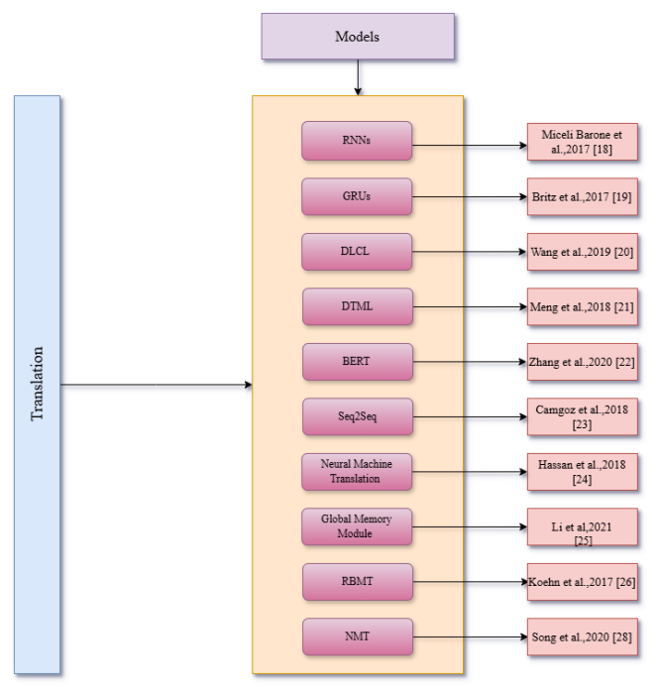
Result and Discussion
Figure 3: Popular Deep Learning Models for the Reading Comprehension Task
Figure 4: Popular Deep Learning Models for Translation Task

Slide 12
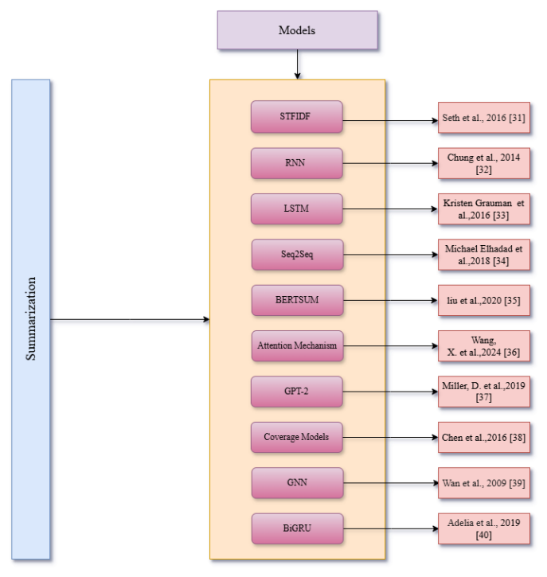
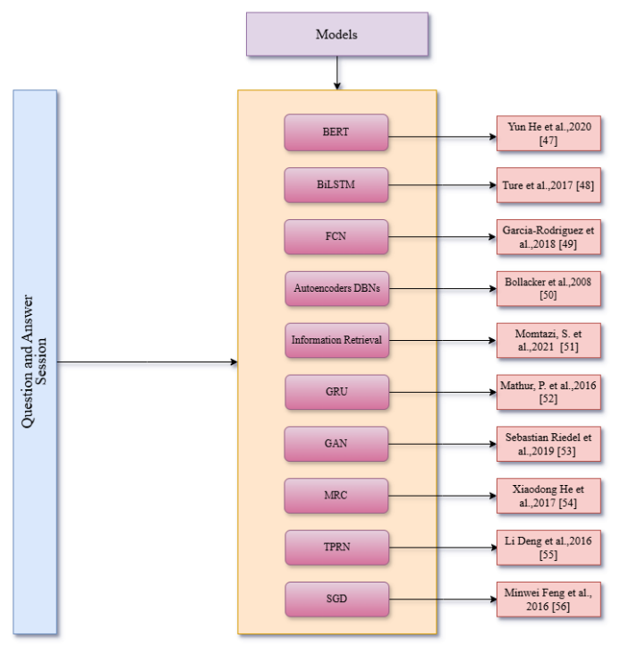
Result and Discussion
Result and Discussion
Figure 6: Popular Deep Learning Models for the Question & Answering Task
Figure 5: Popular Deep Learning Models for the Summarization Task
Notes:
New Courses replaced with New Programmes

Slide 13
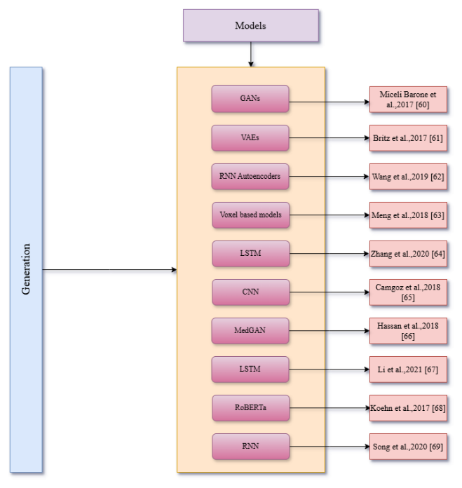
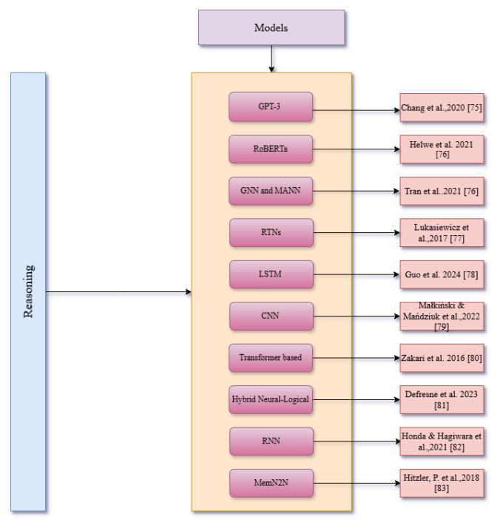
Result and Discussion
Result and Discussion
Result and Discussion
Figure 7: Popular Deep Learning Models for the Generation Task
Figure 8: Popular Deep Learning Models for the Reasoning Task
Notes:
New Courses replaced with New Programmes

Slide 14
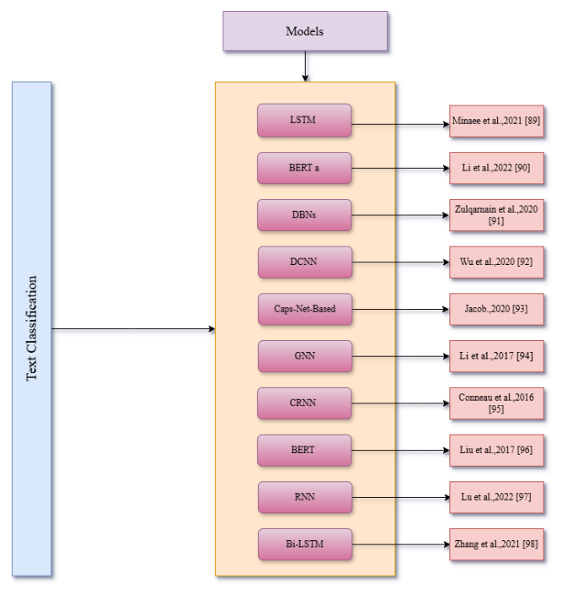
Result and Discussion
Result and Discussion
Result and Discussion
Figure 9: Popular Deep Learning Models for the Text Classification Task

Slide 15
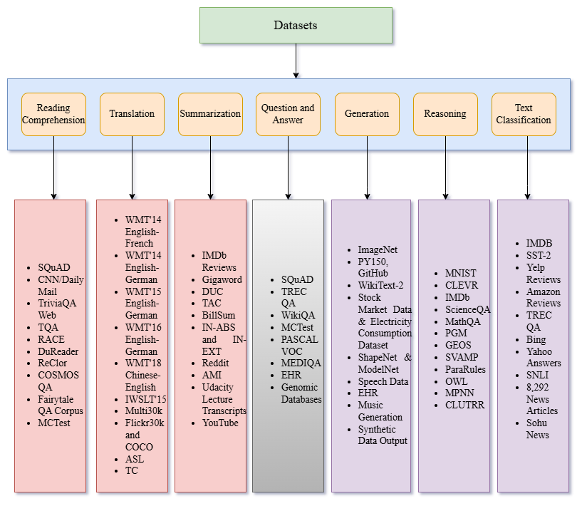
Result and Discussion
Result and Discussion
Result and Discussion
Figure 10: Popular Datasets used for different Deep Learning Tasks

Slide 16
Conclusion
✅Deep learning has transformed task-specific applications such as classification, summarization, translation, reasoning, and question answering.
✅Transformer-based models (BERT, GPT, T5) outperform traditional models due to their deep contextual understanding.
✅Challenges remain in computational costs, interpretability, generalization, and bias.
Future Directions:
➡Efficient & Explainable AI – Reducing computational complexity while ensuring transparency.
➡Improved Generalization – Enhancing adaptability across diverse datasets and domains.
➡Ethical AI Development – Addressing fairness, bias reduction, and responsible AI use.
➡Hybrid AI Approaches – Combining deep learning with traditional reasoning for better performance.
Final Thought: Deep learning continues to evolve, but addressing these challenges is essential for sustainable and responsible AI advancement.
Notes:
New Courses replaced with New Programmes

Slide 17
References
Lu, J., & Rodriguez, I. (2024, March). Deep Manifold Learning for Reading Comprehension and Logical Reasoning Tasks with Polytuplet Loss. In Future of Information and Communication Conference (pp. 337-345). Cham: Springer Nature Switzerland
Perkoff, E. M., Bhattacharyya, A., Cai, J., & Cao, J. (2023, July). Comparing Neural Question Generation Architectures for Reading Comprehension. In Proceedings of the 18th Workshop on Innovative Use of NLP for Building Educational Applications (BEA 2023) (pp. 556-566).
Bahdanau, D., Cho, K., & Bengio, Y. (2014). Neural machine translation by jointly learning to align and translate. arXiv preprint arXiv:1409.0473.
Wang, Q., Li, B., Xiao, T., Zhu, J., Li, C., Wong, D. F., & Chao, L. S. (2019). Learning deep transformer models for machine translation. arXiv preprint arXiv:1906.01787
Abdel-Salam, S., & Rafea, A. (2022). Performance study on extractive text summarization using BERT models. Information, 13(2), 67
Nallapati, R., Zhou, B., Gulcehre, C., & Xiang, B. (2016). Abstractive text summarization using sequence-to-sequence rnns and beyond. arXiv preprint arXiv:1602.06023
Zhang, C., Lai, Y., Feng, Y., & Zhao, D. (2021). A review of deep learning in question answering over knowledge bases. AI Open, 2, 205-215.
Notes:
New Courses replaced with New Programmes

Slide 18
References
Abbasiantaeb, Z., & Momtazi, S. (2021). Text‐based question answering from information retrieval and deep neural network perspectives: A survey. Wiley Interdisciplinary Reviews: Data Mining and Knowledge Discovery, 11(6), e1412
Lu, Y., Shen, M., Wang, H., Wang, X., van Rechem, C., Fu, T., & Wei, W. (2023). Machine learning for synthetic data generation: a review. arXiv preprint arXiv:2302.04062.
Lu, S., Guo, D., Ren, S., Huang, J., Svyatkovskiy, A., Blanco, A., ... & Liu, S. (2021). Codexglue: A machine learning benchmark dataset for code understanding and generation. arXiv preprint arXiv:2102.04664
A Survey on Raven's Progressive Matrices- Małkiński, M., & Mańdziuk, J. (2022). Deep learning methods for abstract visual reasoning: A survey on raven's progressive matrices. ACM Computing Surveys.
Liu, P., Qiu, X., & Huang, X. (2017). Adversarial multi-task learning for text classification. arXiv preprint arXiv:1704.05742.
Zhang, M. (2021). Applications of deep learning in news text classification. Scientific Programming, 2021(1), 6095354.
Radford, A., Narasimhan, K., Salimans, T., & Sutskever, I. (2018). Improving language understanding by generative pre-training.

Slide 19
THANK YOU

